Slide 1
Keras visualization and Utils
-Dhanshri More

Slide 2
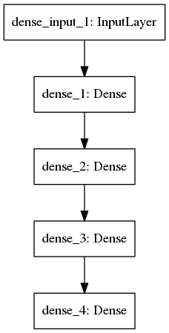
Keras visualization
keras.utils.visualize_util module provides utility functions to plot a Keras model using graphviz.
from keras.utils.visualize_util import plot
plot(model, to_file='Keras model.png')
plot takes two optional arguments:
show_shapes: (defaults to False) controls whether output shapes are shown in the graph.
show_layer_names: (defaults to True) controls whether layer names are shown in the graph.

Slide 3
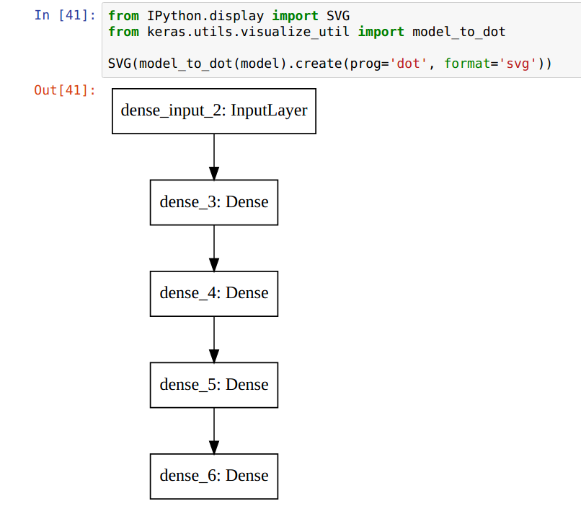
You can also directly obtain the pydot.Graph object and render it yourself
Eg.

Slide 4
SVG
Scalable Vector Graphics (SVG) is an XML-based vector image format for two-dimensional graphics with support for interactivity and animation. The SVG specification is an open standard developed by the World Wide Web Consortium (W3C) since 1999. SVG images and their behaviors are defined in XML text files.

Slide 5
Keras Utils
Data Utils:
Function:
get_file(fname, origin, untar=False, md5_hash=None, cache_subdir='datasets')
Description: Downloads a file from a URL if it not already in the cache.
Arguments:
fname: name of the file
origin: original URL of the file
untar: boolean, whether the file should be decompressed
md5_hash: MD5 hash of the file for verification
cache_subdir: directory being used as the cache

Slide 6
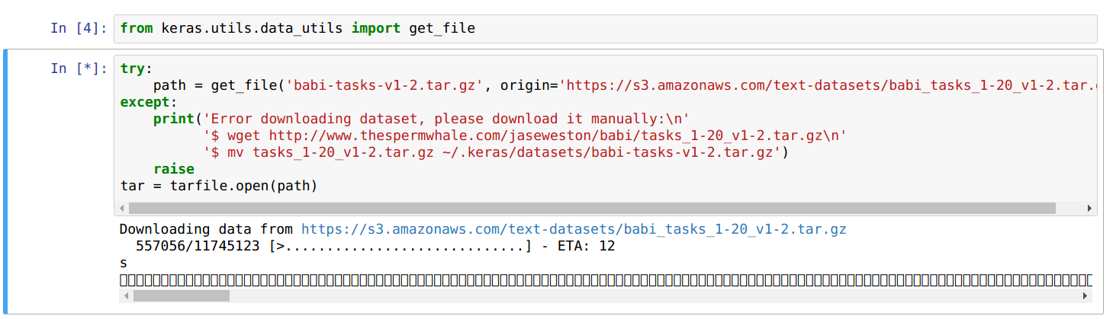
Data Util Python execution:

Slide 7
I/O util
HDF5 dataset can be used instead of a Numpy array.
Function:
keras.utils.io_utils.HDF5Matrix(datapath, dataset, start=0, end=None, normalizer=None)
Arguments:
datapath: string, path to a HDF5 file
dataset: string, name of the HDF5 dataset in the file specified in datapath
start: int, start of desired slice of the specified dataset
end: int, end of desired slice of the specified dataset
normalizer: function to be called on data when retrieved

Slide 8
I/O util : HDF5
An HDF5 dataset is an object composed of a collection of data elements, raw data, and metadata that stores a description of the data elements, data layout, and all other information necessary to write, read, and interpret the stored data. From the viewpoint of the application the raw data is stored as a one-dimensional or multi-dimensional array of elements (the raw data), those elements can be any of several numerical or character types, small arrays, or even compound types similar to C structs. The Dataset object may have Attribute objects

Slide 9
Imagenet Example
If you have a huge dataset as an HDF5 file, you can use keras.utils.io_utils.HDF5Matrix to load the dataset.
It will only read one batch at a time from memory, but there's some limitations (e.g., you cannot read shuffled data from the file, only sequentially).
A workaround would be to shuffle the data before you store it to disk (but you would still read the same batches after a full epoch).
Eg. Considers you have all of your samples in the same HDF5 file, and features and targets are in HDF5 datasets named 'features' and 'targets':
def load_data(datapath, train_start, train_end, n_training_examples, n_test_examples)
X_train = HDF5Matrix(datapath, 'features', train_start, train_start+n_training_examples, normalizer=normalize_data)
y_train = HDF5Matrix(datapath, 'targets', train_start, train_start+n_training_examples)
X_test = HDF5Matrix(datapath, 'features', test_start, test_start+n_test_examples, normalizer=normalize_data)
y_test = HDF5Matrix(datapath, 'targets', test_start, test_start+n_test_examples)
return X_train, y_train, X_test, y_test

Slide 10
Layer Util
Layer util gives layer instance with given configuration
Function:
layer_from_config(config, custom_objects=None)
Argument:
config: dict of the form {'class_name': str, 'config': dict}
custom_objects: dict mapping class names (or function names) of custom (non-Keras) objects to class/functions

Slide 11
References
https://keras.io/
https://github.com/fchollet/keras/tree/master/keras/utils

Slide 12
Thank you!

